Slide 1
AUTOMATA & COMPUTABILITY
CSE 331, CSE BRAC

Slide 2
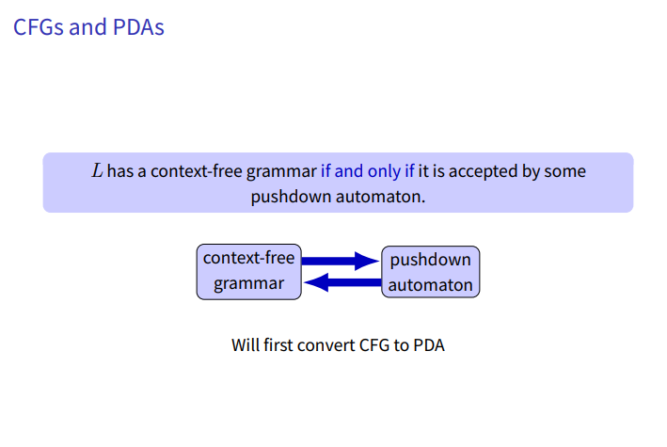
CFG to PDA

Slide 3
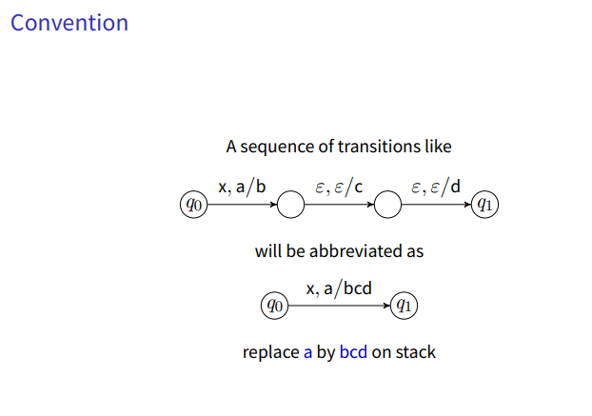
CFG to PDA

Slide 4
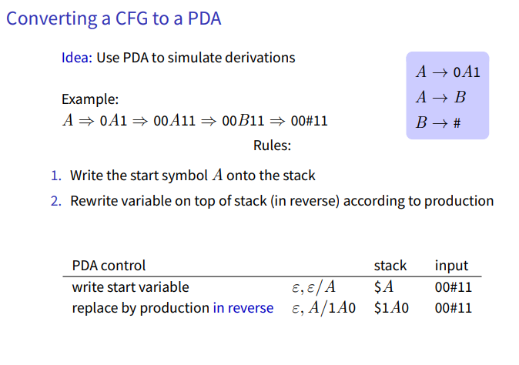
CFG to PDA

Slide 5
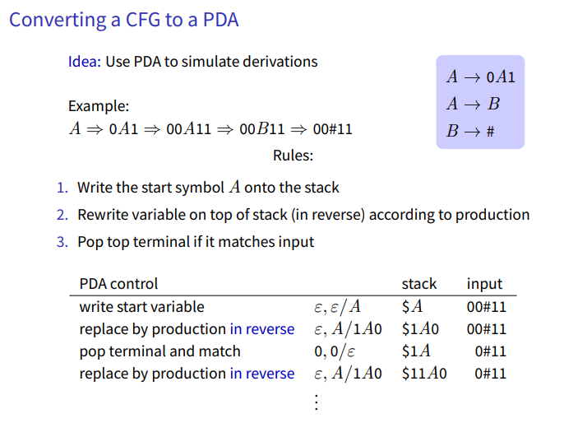
CFG to PDA

Slide 6
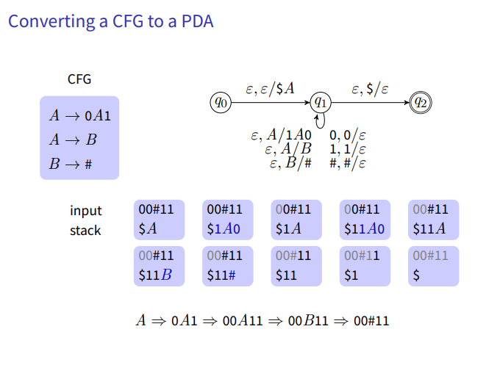
CFG to PDA

Slide 7
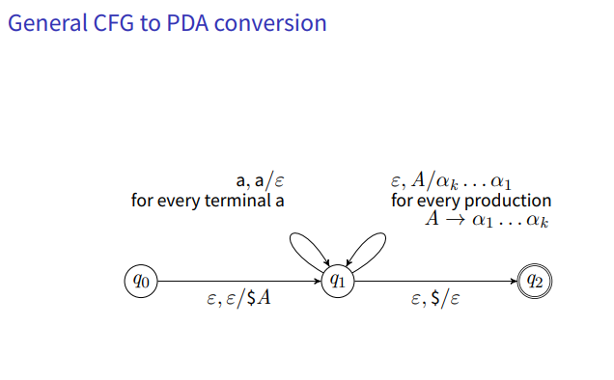
CFG to PDA

Slide 8
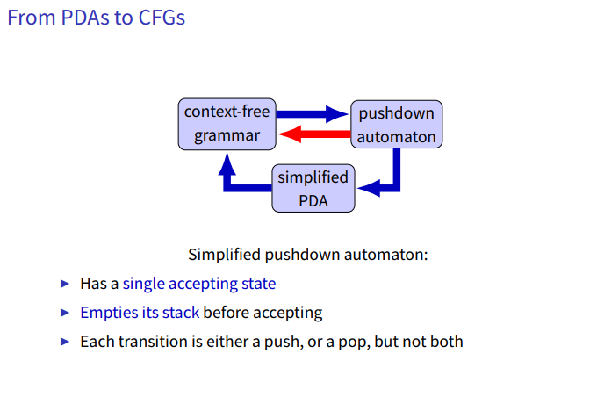
PDA to CFG

Slide 9
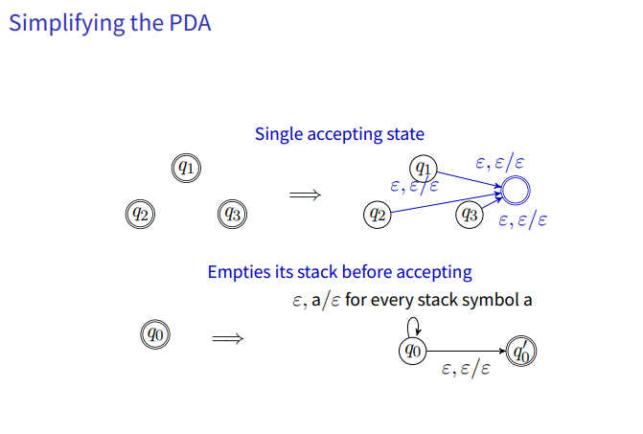
PDA to CFG

Slide 10
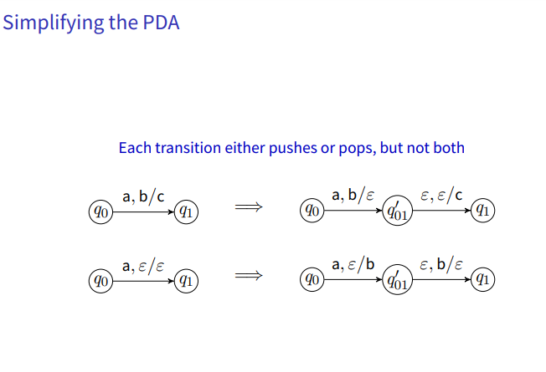
PDA to CFG

Slide 11
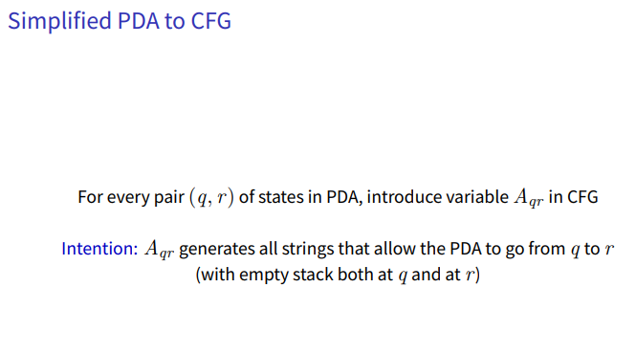
PDA to CFG

Slide 12
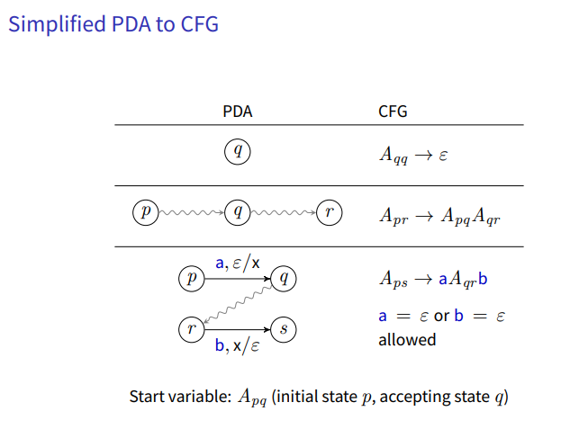
PDA to CFG

Slide 13
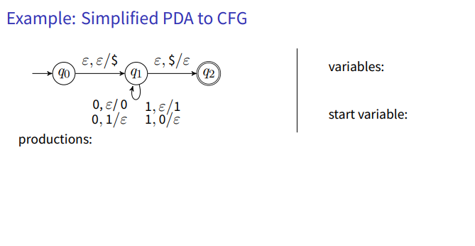
PDA to CFG

Slide 14
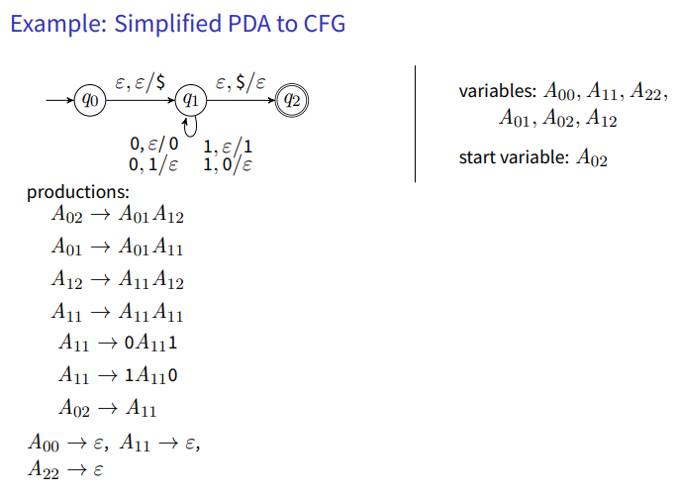
PDA to CFG

Slide 15
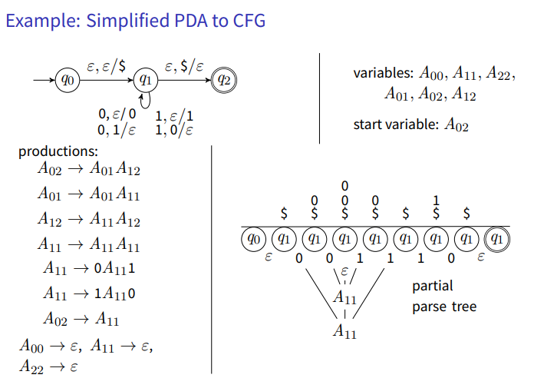
PDA to CFG

Slide 16
Thank You

